Slide 1


Stats Analysis
想不到組名 π^π
By 黃程奕、張筱萍、林鈺筌

Slide 2
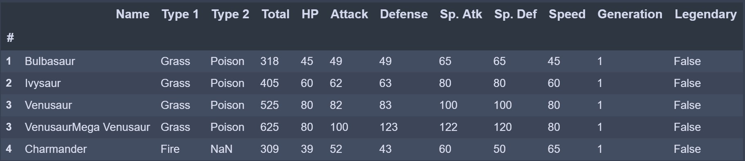
Data Introduction
721 Pokemons (from Kaggle)
Name、Type、HP、Attack、Defense.etc
Notes:
This data set includes 721 Pokemon, including their number, name, first and second type, and basic stats: HP, Attack, Defense, Special Attack, Special Defense, and Speed. It has been of great use when teaching statistics to kids. With certain types you can also give a geeky introduction to machine learning.

Slide 3
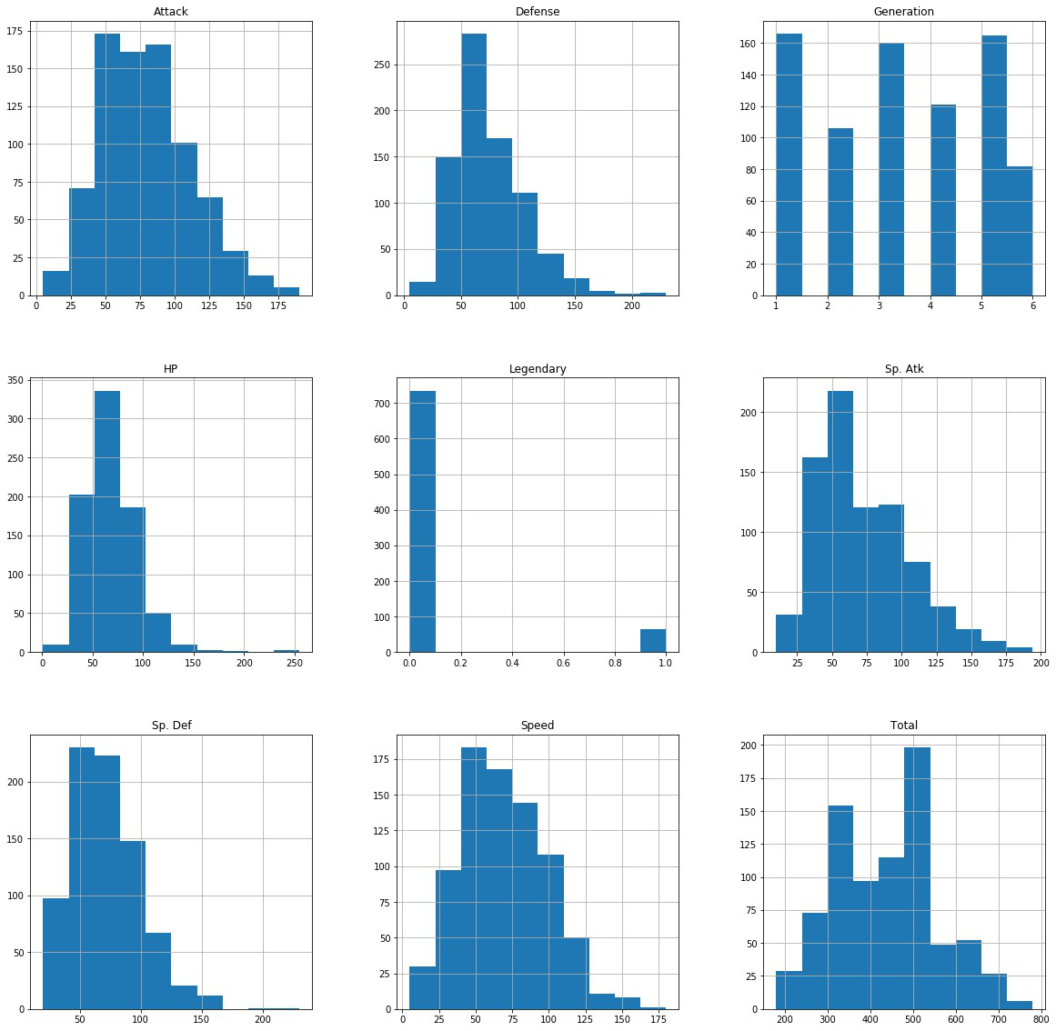
Visualize

Slide 4

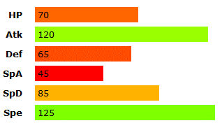


Problem Defining
Predict a Pokemon’s type by its basic stats？
?

Slide 5
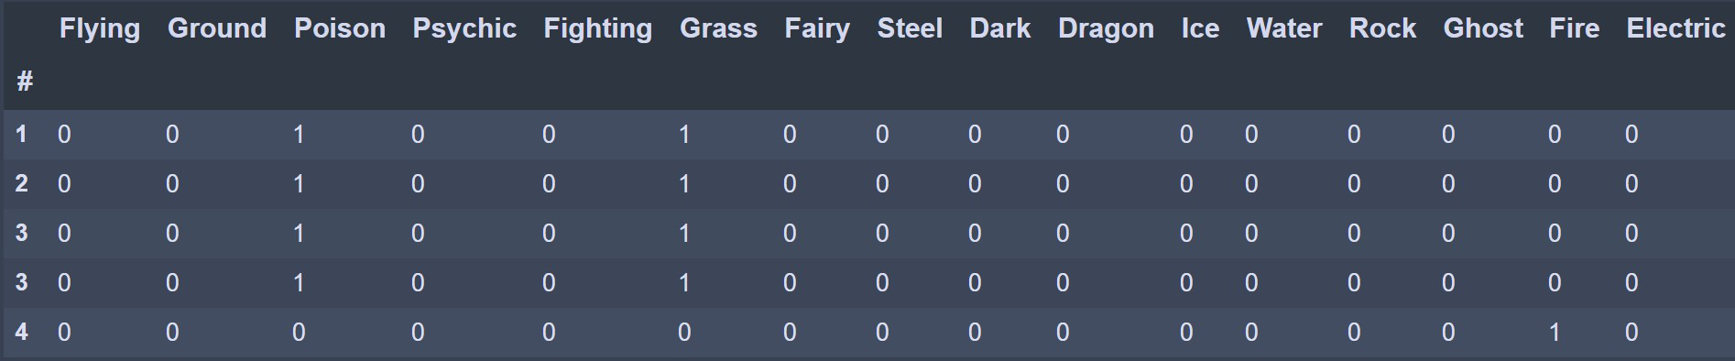
Data Preprocessing
Data Extraction for ‘type’

Slide 6
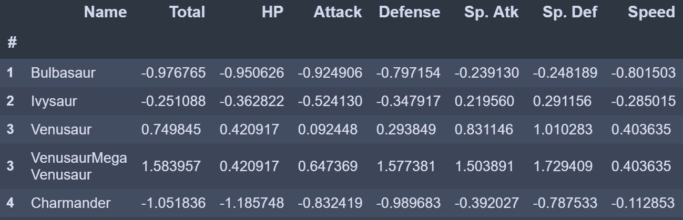
Data Preprocessing
Standardization

Slide 7
Model
DNN

Slide 8
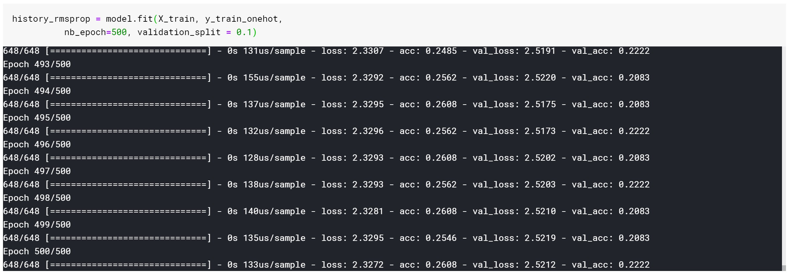
DNN

Slide 9
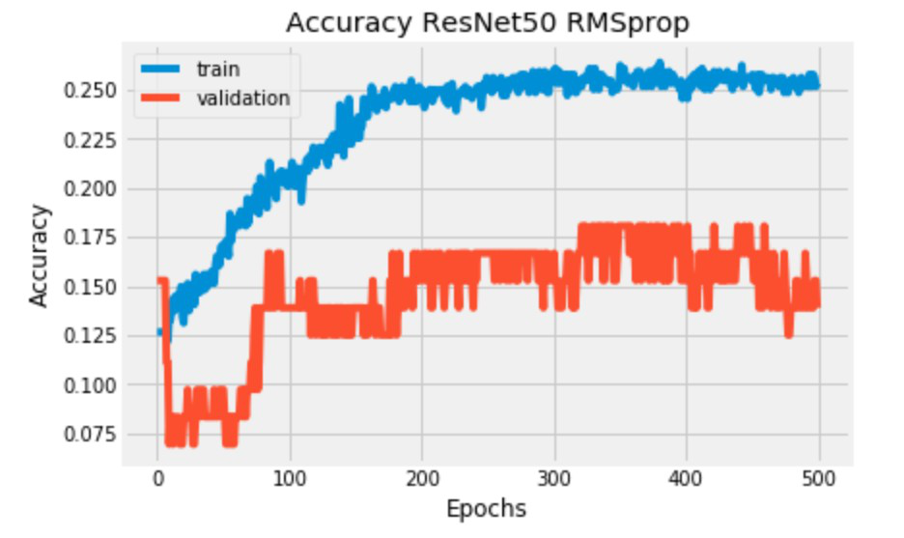
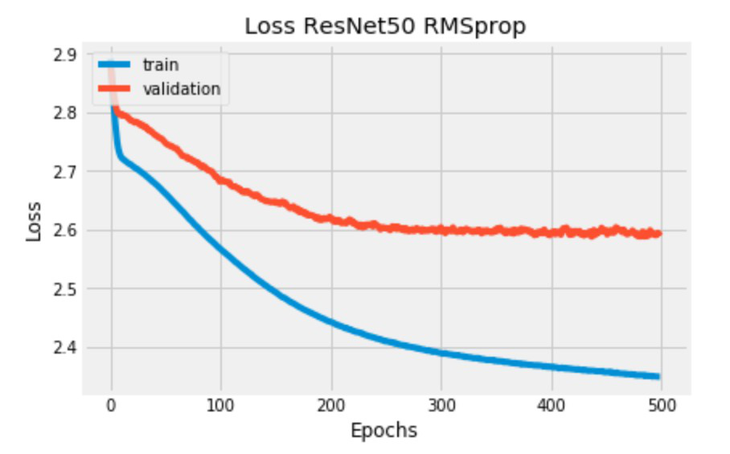
Plot the Accuracy

Slide 10
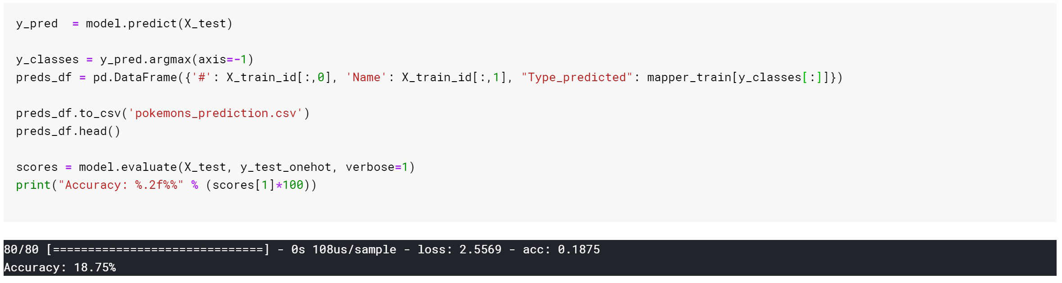
DNN
Accuracy：18.75%

Slide 11
Result & Discussion
Low accuracy
Reason：the basic stats among different types are similar

Slide 12

Problem reDefining
Predict if it’s legendary by its basic stats？
?

Slide 13
Model
KNN
Random Forest
Logistic Regression

Slide 14
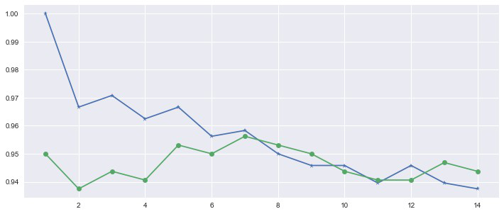
KNN
Find best k
Train data
k = 7
Test data

Slide 15
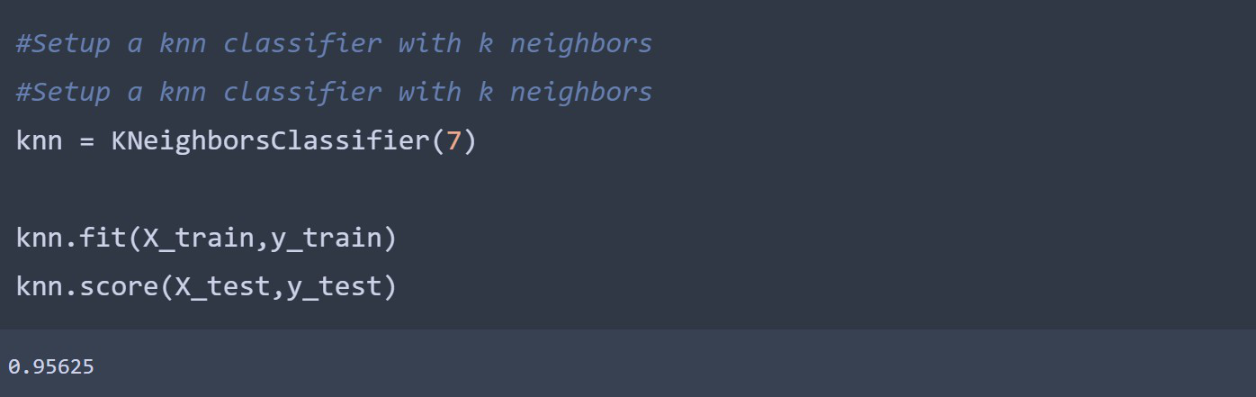
KNN
Accuracy：0.95625

Slide 16
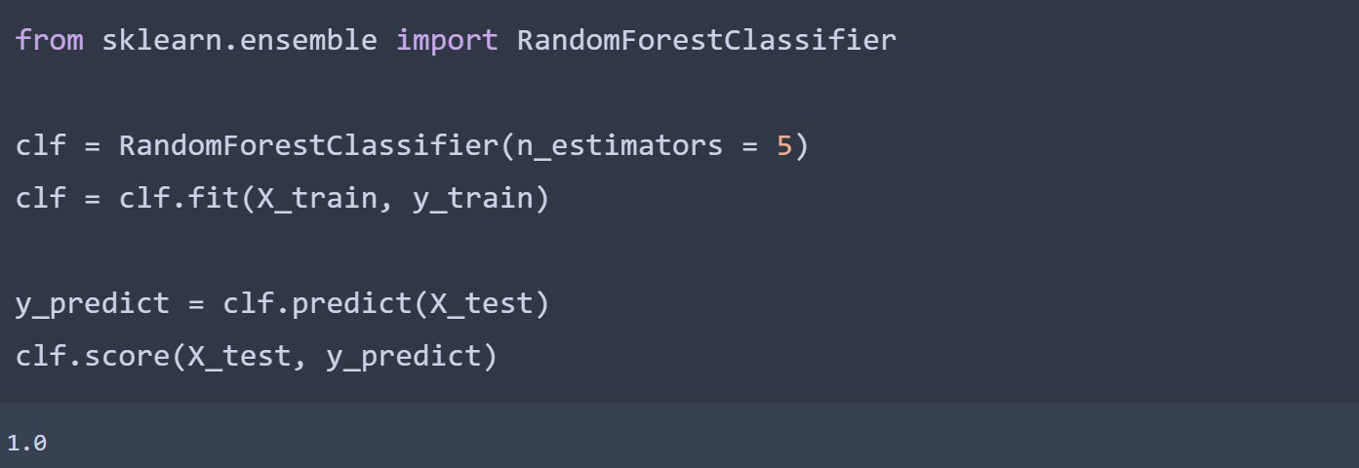
Random Forest
Accuracy：1

Slide 17
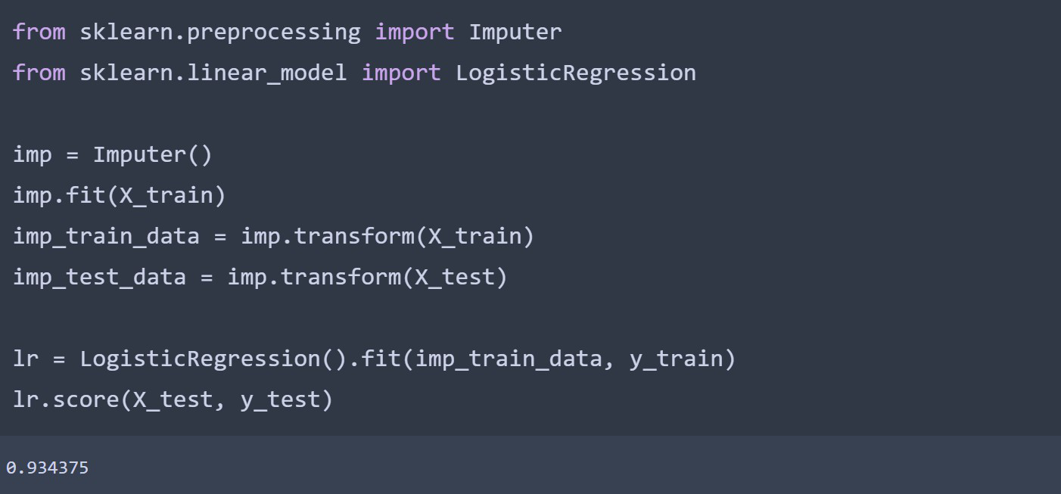
Logistic Regression
Accuracy：0.934375

Slide 18
Result & Discussion
High accuracy
Reason：legendary pokemons have significant higher basic stats

Slide 19
對模組化的建議&期許
著重於特定主題
公布所需先備知識
課程時數加長

